Slide 1
CDMA Technologies for Cellular Phone System
Week 16 Lecture 1

Slide 2
Evolution of Cellular Systems
3rd. Generation
(2000s)
2nd. Generation
(1990s)
IMT-2000
CDMA2000
W-CDMA
1st.Generation
(1980s)
Digital
GSM DECT
DCS1800 CT2
PDC PHS
IS-54
IS-95
IS-136
UP-PCS
Analog
NMT CT0
TACS CT1
AMPS

Slide 3
Requirements for 3G mobile systems
High Capacity
Tolerance for interference
Privacy
Tolerance for fading
Ability to various data rate transmission
Flexible QoS
CDMA meets all of them!

Slide 4

Multiple Access Methods
Base Station
Forward link
Reverse link
Mobile Station
Mobile Station
Mobile Station
Mobile Station

Slide 5
Frequency Division Duplex (FDD)
Forward link frequency and reverse link frequency is different
In each link, signals are continuously transmitted in parallel.
Forward link (F1)
Reverse link (F2)
Base Station
Mobile Station

Slide 6
Example of TDD Systems
Mobile Station
Base Station
Transmitter
Transmitter
BPF
BPF
Receiver
F1
F1
Receiver
Synchronous Switches
BPF: Band Pass Filter

Slide 7
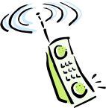
What is CDMA ?
Use codes to spread spectrum
Base-band Spectrum
Radio Spectrum
Code B
B
Code A
B
Frequency
Code A
A
A
B
C
C
C
A
B
B
B
A
A
A
C
B
Sender
Time
Receiver

Slide 8
CDMA – Based on Spread Spectrum Technology

Slide 9
How to spread spectrum...
Direct Sequence (DS)
Power
Density
user data
TIME
Modulation
(primary modulation)
data rate
Base-band
Frequency
spreading sequence
(spreading code)
Spreading
(secondary modulation)
Power
Density
10110100
Radio
Frequency
Tx

Slide 10

Demodulating DS Signals (1/2)
If you know the correct spreading sequence (code) ,
Power
Density
received signal
TIME
10110100
01001011
10110100
spreading sequence
(spreading code)
Radio
Frequency
you can find the spreading timing
which gives the maximum detected power, and
10110100
10110100
10110100
gathering energy !
Accumulate for
one bit duration
00000000
11111111
00000000
Demodulated data
Base-band
Frequency
0
1
0

Slide 11
Demodulating DS Signals (2/2)
If you don’t know the correct spreading sequence (code) •••
Power
Density
received signal
TIME
10110100
01001011
10110100
spreading sequence
(spreading code)
Radio
Frequency
you cannot find the spreading timing
without correct spreading code, and
10101010
10101010
10101010
10110100
10110100
10110100
Accumulate for
one bit duration
No data can be detected
Demodulated data
-
-
-
Base-band
Frequency

Slide 12
Feature of SS
Privacy, Security
Power density of SS-signals could be lower than the noise density.
Power
Density
Power
Density
Power
Density
Noise
Radio
Frequency
Radio
Frequency
Base-band
Frequency
••••••
••••••
With correct code
(and carrier frequency),
data can be detected.
transmitted SS-signal
received signal
de-modulator
With incorrect code
(or carrier frequency),
SS-signal itself
cannot be detected.
Noise
Power
Density
They cannot perceive the existence of communication, because of signal behind the noise.
Base-band
Frequency
Notes:
。

Slide 13
DS-CDMA System Overview
(Forward link)
CDMA is a multiple spread spectrum.
Freq.
Freq.
Freq.
Freq.
Data A
BPF
BPF
Despreader
Data A
MS-A
Code A
Code A
Freq.
Freq.
Freq.
Freq.
Data B
BPF
BPF
Despreader
Data B
Code B
MS-B
Code B
BS
•••
•••
Difference between each communication path is only the spreading code
Notes:
。

Slide 14
DS-CDMA (two types)
Synchronous DS-CDMA :
  Perfect Orthogonal Codes are used. (Walsh code etc.)
Asynchronous DS-CDMA :
  Pseudo-random Noise (PN) codes
  e.g. Gold codes

Slide 15
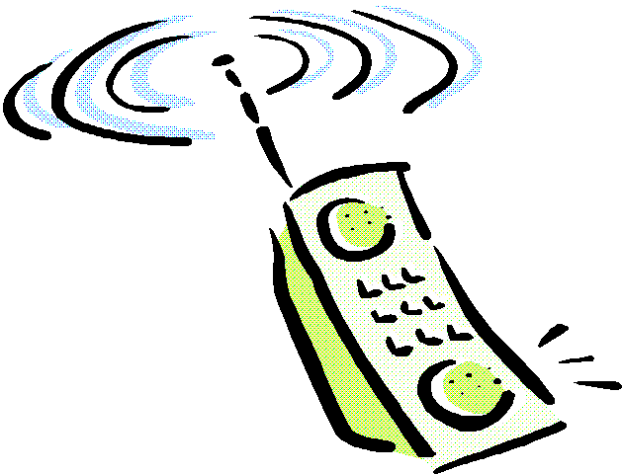
1. Asynchronous DS-CDMA
Reverse Link
(Up Link)
Asynchronous Chip Timing
A
B
B
Big Interference
from A station
A
Signal for B Station
(after re-spreading)
Signals from A and B are interfering each other.

Slide 16
2. Synchronous DS-CDMA
Synchronous CDMA Systems realized in Point to Multi-point System.
e.g., Forward Link (Base Station to Mobile Station) in Mobile Phone.
Forward Link
(Down Link)
Synchronous Chip Timing
Ａ Ｂ
A
A
Less Interference for A station
Signal for B Station
(after re-spreading)

Slide 17
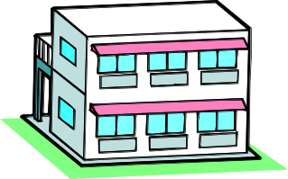
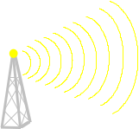
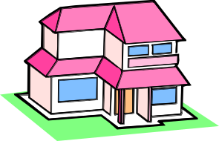
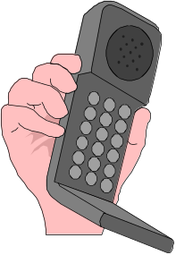
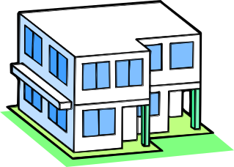
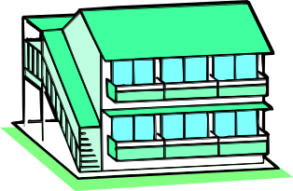
Mobile Propagation Environment ･･･ Multi-path Fading
Power
path-1
path-2
path-3
multi-path propagation
path-2
Path Delay
path-1
path-3
Mobile Station (MS)
Base Station (BS)
Power
The peaks and bottoms of received power appear, in proportion to Doppler frequency.
Time

Slide 18
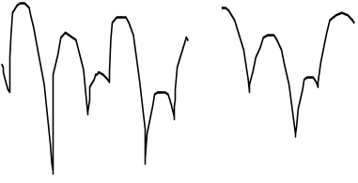
Fading in non-CDMA System
path-1
With low time-resolution,
different signal paths cannot be discriminated.
•••
These signals sometimes strengthen,
and sometimes cancel out each other,
depending on their phase relation.
••• This is “fading”.
•••
In this case, signal quality is damaged
when signals cancel out each other.
In other words, signal quality is dominated
by the probability for detected power
to be weaker than minimum required level.
This probability exists with less than two paths.
Power
path-2
path-3
Path Delay
Power
Detected Power
Time
In non-CDMA system, “fading” damages signal quality.

Slide 19
Fading in CDMA System ...
path-1
Because CDMA has high time-resolution,
different path delay of CDMA signals
can be discriminated.
•••
Therefore, energy from all paths can be summed
by adjusting their phases and path delays.
••• This is a principle of RAKE receiver.
Power
path-2
path-3
Path Delay
path-1
interference from path-2 and path-3
CDMA
Receiver
Power
path-3
CODE A
with timing of path-1
Path Delay
path-2
Synchronization
Adder
Power
CDMA
Receiver
path-1
Power
path-2
•••
CODE A
with timing of path-2
Path Delay
•••

Slide 20
Fading in CDMA System (continued)
In CDMA system, multi-path propagation improves
the signal quality by use of RAKE receiver.
path-3
Power
path-2
path-1
Detected Power
Power
RAKE
receiver
Time
Less fluctuation of detected power, because of adding all energy .

Slide 21
Near-Far Problem
P
PL-a
DATA A
CDMA
Transmitter
CDMA
Receiver
Demodulated DATA
CODE A
P
PL-b
CODE A
CDMA
Transmitter
DATA B
When user B is close to the receiver and
user A is far from the receiver,
Path loss a (PL-a) could be much bigger than PL-b.
In this case, desired signal power is
smaller than the interfered power.
CODE B

Slide 22
Power Control...
When all mobile stations transmit the signals at the same power (MS),
the received levels at the base station are different from each other,
which depend on the distances between BS and MSs.
Moreover, the received level fluctuates quickly due to fading.
In order to maintain the received level at BS, power control technique must be
employed in CDMA systems.
from A
Detected Power
from B
Time
Ｂ
Ａ

Slide 23
Power Control (continued)
Open Loop Power Control
Closed Loop Power Control
Only MH does something; BS doesn’t do anything!
（（（
①
②
measuring received power
decide transmission power
②
transmit
power control command
estimating path loss
about 1000 times per second
calculating transmission power
transmit
measuring received power
①
Transmit next

Slide 24

Frequency Allocation (1/2)
In FDMA or TDMA,
radio resource is allocated not to interfere among neighbor cells.
Neighbor cells cannot use the same (identical) frequency band (or time slot).
The left figure shows the simple cell allocation with seven bands of frequency.
In actual situation, because of complicated radio propagation and irregular cell allocation, it is not easy to allocate frequency (or time slot) appropriately.
f3
f4
f2
f1
f5
f7
f6
cell :
a “cell” means covered area by one base station.

Slide 25
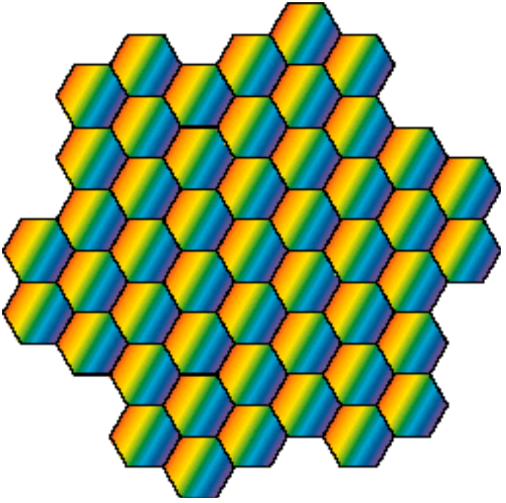
Frequency Allocation (2/2)
In CDMA,
identical radio resource can be used among all cells,
because CDMA channels use same frequency simultaneously.
Frequency allocation in CDMA is not necessary.
In this sense, CDMA cellular system is easy to be designed.

Slide 26

Soft Handoff (1/2)
Handoff :
  Cellular system tracks mobile stations in order to maintain their communication links.
  When mobile station goes to neighbor cell, communication link switches from current cell to the neighbor cell.
Hard Handoff :
  In FDMA or TDMA cellular system, new communication establishes after breaking current communication at the moment doing handoff. Communication between MS and BS breaks at the moment switching frequency or time slot.
switching
Cell B
Cell A
Hard handoff : connect (new cell B) after break (old cell A)

Slide 27
Soft Handoff (2/2)
Soft Handoff :
  In CDMA cellular system, communication does not break even at the moment doing handoff, because switching frequency or time slot is not required.
transmitting same signal from both BS A and BS B simultaneously to the MS
Σ
Cell B
Cell A
Soft handoff : break (old cell A) after connect (new cell B)

Slide 28
Conclusion
CDMA is based on the spread spectrum technique which has been used at military field.
CDMA cellular system is deemed superior to the FDMA and TDMA cellular systems for the time being.
Therefore, CDMA technique becomes more important in radio communication systems.

